Slide 1
Guidelines for cultural tourism development
Dorotea Ottaviani, UNIBO

Slide 2
What can you expect from this webinar?
This is a step-by-step guide to achieve sustainable cultural tourism.
This guidance is useful for any local community interested in developing their tourism sector through own heritage resources.
Based on the TExTOUR methodology there are seven steps.
By following this guidance, you can expect to have a ready action plan on how to boost your cultural tourism based on local heritage resources.
While following the TExTOUR guidance, you can call yourself a TExTOUR Replicator!

Slide 3
What is an action plan?
A cultural tourism-led action plan aims consists of a number of actions that will together achieve a greater strategy for the local community.
TExTOUR encourages a valorisation and use of cultural and natural heritage as the resources in each action.
Each Replicator is expected to learn, replicate, and tailor actions from other good practices of cultural tourism.

Slide 4
What are milestones?
The milestones (#M) are achievements on the Replicator’s journeys to reenergize their territories and are necessary steps to build their cultural tourism-led action plans.
It is considered necessary to achieve the milestones in the right order to be able to move forward to the next step.

Slide 5
Steps to achieve sustainable Cultural Tourism development

Slide 6
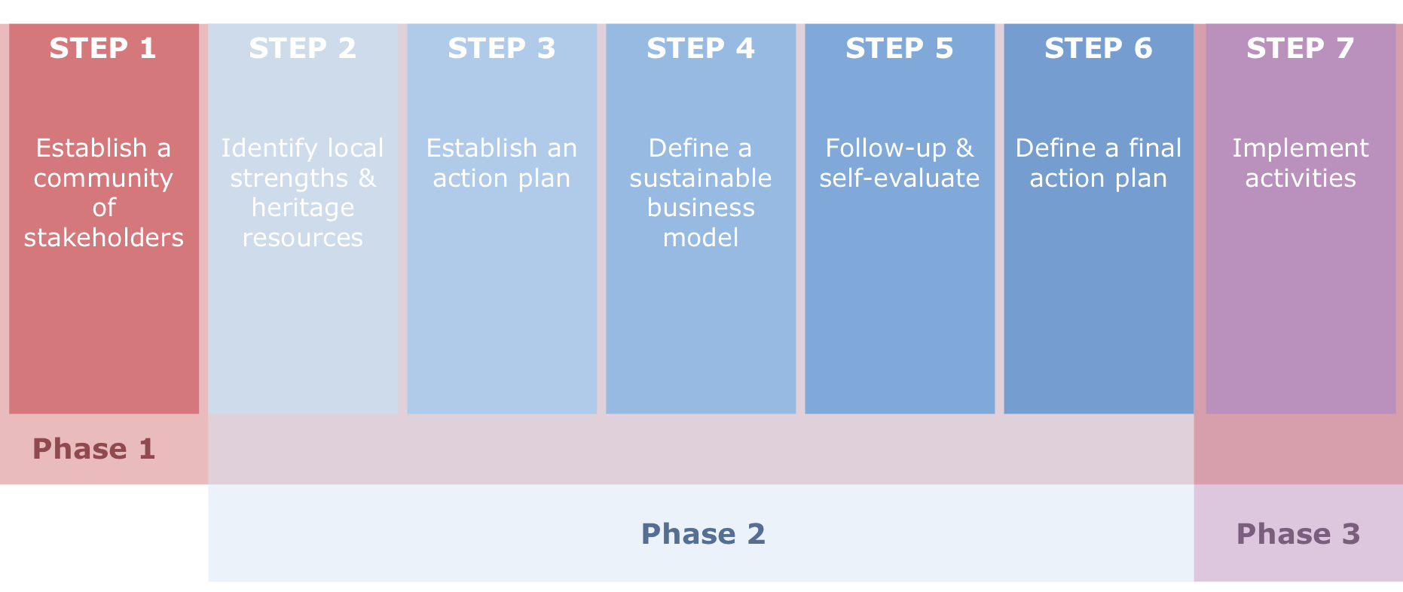
A six-step methodology

Slide 7
First phase Participatory establishment

Slide 8
Step 1: Establish a community of involved stakeholders
Time estimation: 1 month → through the entire project
Milestone #1: Established a stakeholder community

Slide 9
Step 1: Establish a community of involved stakeholders What is a stakeholder?
Stakeholders included in four diverse types: public organization, private business, civic sector, mixed organizations. Non-governmental organisations (NGOs) are special type of stakeholders, as they can represent different governance arrangements (public-civic, public-private, private-civic).
Stakeholders are subsequently divided according to their field of activity: Public administration, Financial sector, Culture, Education, Commerce, Research, Tourism, Gastronomy, etc.

Slide 10
Step 1: Establish a community of involved stakeholders Engaging stakeholders
Stakeholder engagement can be defined as an umbrella term that covers the full range of organizational efforts to understand and involve stakeholders and communities in activities and decisions.
It can help organizations meet tactical and strategic needs, improve transparency, and build the trust of the individuals or groups whose support is critical to the long-term success of the project.

Slide 11
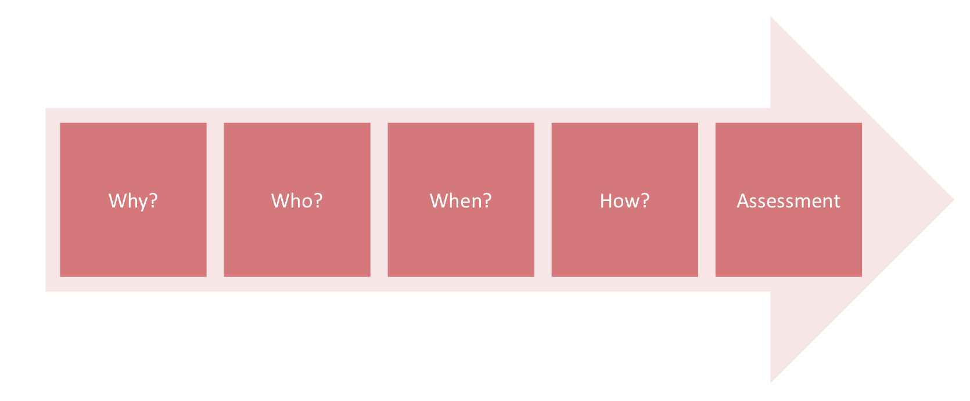
Step 1: Establish a community of involved stakeholders Engaging stakeholders

Slide 12
Step 1: Establish a community of involved stakeholders Why engage stakeholders?
Even before stakeholder engagement begins, it is necessary to define the purpose of the engagement: why is it necessary to engage the people, what is the common goal we want to achieve?
Once these questions are answered can the stakeholder engagement start with the process of identification. It is a process that requires a structured approach, consisting of the consecutive actions that enable a successful mapping of interested stakeholder and community groups, as well as the best methods to reach them.

Slide 13
Step 1: Establish a community of involved stakeholders Why engage stakeholders?

Slide 14
Step 1: Establish a community of involved stakeholders Who to engage?
The process always includes an assessment for monitoring purposes, putting a feed-back loop in place. This means to be precise:
Identifying the stakeholders and community to be involved: who are to be involved?
This phase includes assessing, analysing, prioritising, and understanding the different incentives

Slide 15
Step 1: Establish a community of involved stakeholders Who to engage?

Slide 16
Step 1: Establish a community of involved stakeholders When to engage stakeholders?
Identifying the best times to engage with stakeholders and community: when should the outreach activities begin and how long should they last?

Slide 17
Step 1: Establish a community of involved stakeholders How to engage stakeholders?
Choosing the best methods for engagement: how can the target groups be best reached, what are the most effective methods? Is it necessary to innovate methodologically?

Slide 18
Step 1: Establish a community of involved stakeholders Assessing engagement
Assessing the engagement process: the last step allows a post-engagement review of the processes, including the possibility of both qualitative and quantitative monitoring and a chance for improvement.

Slide 19
Second phase Co-defining cultural tourism strategies

Slide 20
Step 2: Identify local strengths and heritage resources
Time estimation: Two weeks
Milestone #2: Map of strengths and resources in territory

Slide 21
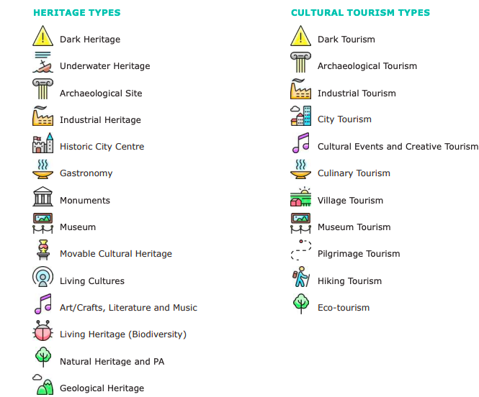
Step 2: Identify local strengths and heritage resources A workshop to identify heritage
Aim: Define a vision shared by the participants as a group and to help them identify both heritage and social resources they could involve in the process.

Slide 22
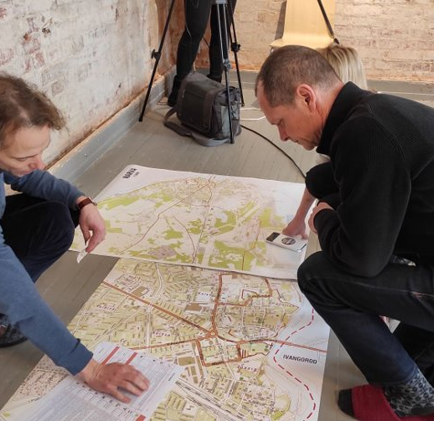
Step 2: Identify local strengths and heritage resources Overview
Method: A workshop
Outcome: Map of strengths and resources in territory

Slide 23
Step 2: Identify local strengths and heritage resources Recommendations

Slide 24
Step 3: Establish an action plan
Time estimation: Two weeks
Milestone #3: A collection of suggested actions

Slide 25
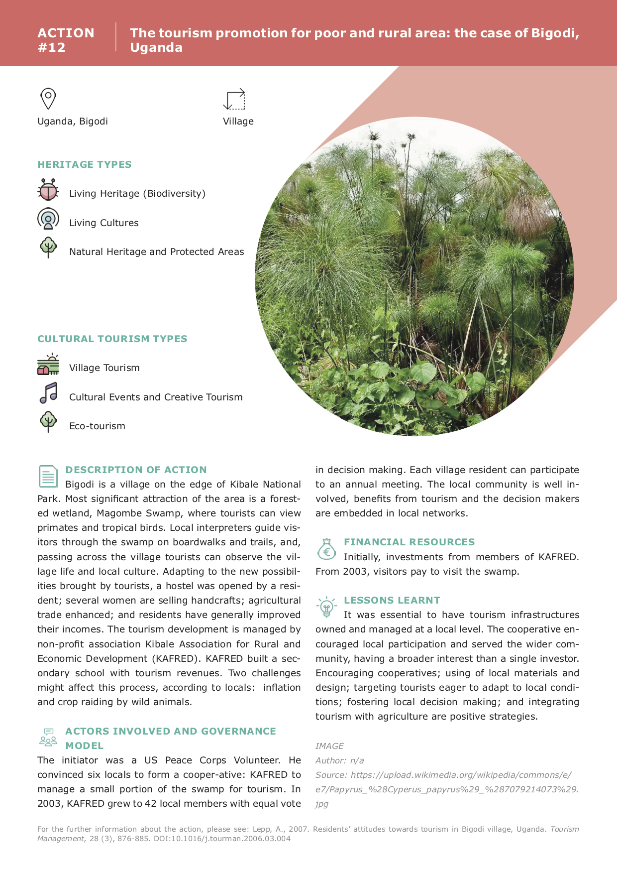
Step 3: Establish an action plan Define actions
Aim: The pilot coordinators and the participants are asked to select and/or create a set of actions that would be based on the goals expressed in the previous workshop. You will collect actions (based on a pre-made set of good heritage-led tourism examples) or create completely new ones. The aim is to highlight and steer reflections on social innovation, technological innovation, sustainability, and inclusion.

Slide 26
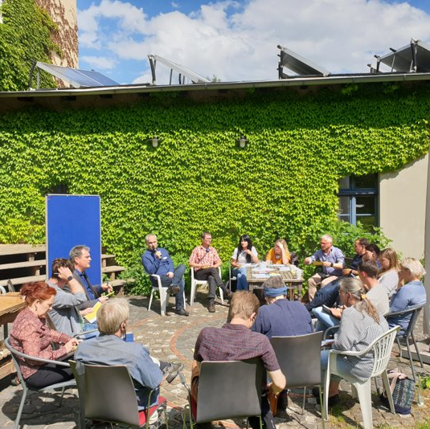
Step 3: Establish an action plan Overview
Method: A workshop
Outcome: Select or develop 3 to 6 actions that will be brought to workshop three.

Slide 27
Step 3: Establish an action plan Recommendations

Slide 28
Step 4: Define a sustainable business model
Time estimation: Two weeks
Milestone #4: A feasible business model

Slide 29
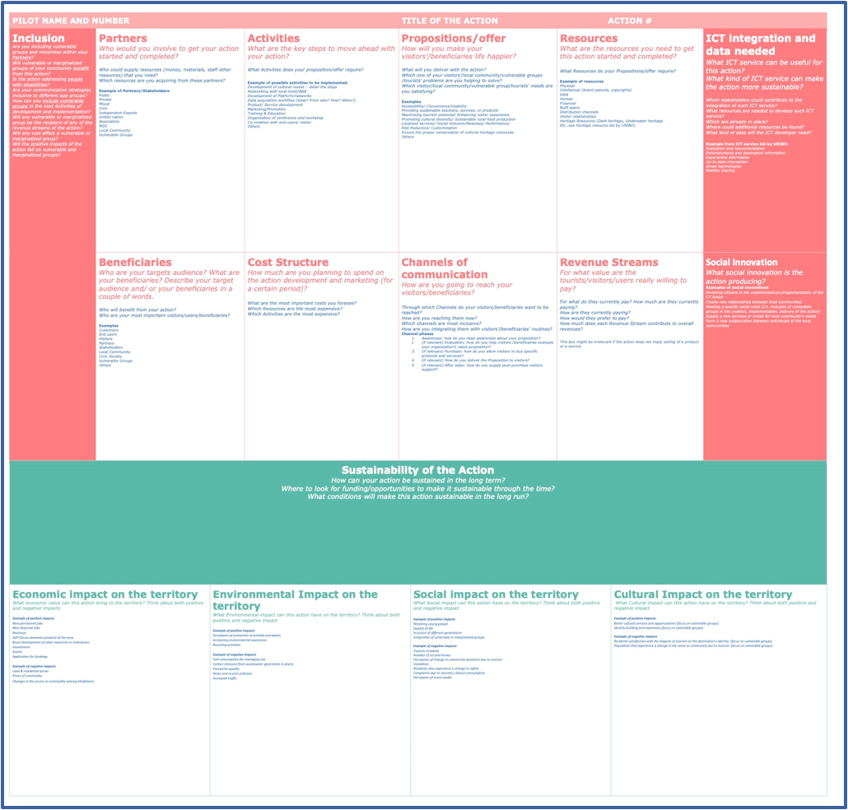
Step 4: Define a sustainable business model Economic viability
Aim: Through a Business Model Canvas adapted to focus on the specific aspects at the core of the project and pivotal to a smart, sustainable, and inclusive development of cultural tourism, the aim is to support the viability of your actions.

Slide 30
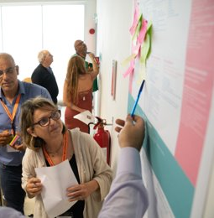
Step 4: Define a sustainable business model Overview
Method: A workshop
Outcome: This activity supports your territory in creating a coherent and realistic action plan.

Slide 31
Step 4: Define a sustainable business model Recommendations

Slide 32
Step 5: Establish a way to follow-up and self-evaluate the action plan
Time estimation: Two weeks
Milestone #5: A set of targets to achieve through the action plan

Slide 33
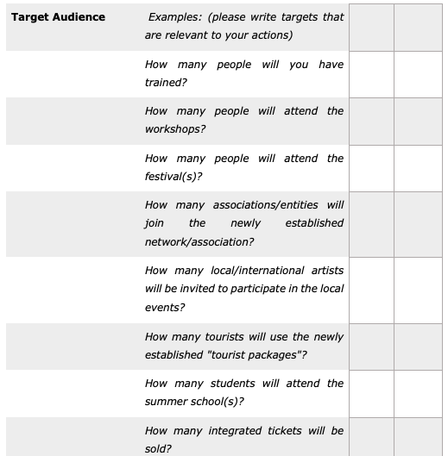
Step 5: Establish a way to follow-up and self-evaluate the action plan Define KPIs
Aim: This step will support your territory in defining feasible and relevant targets that can be achieved through the proposed actions. Once the types of targets are defined, measurable figures are assigned to each target.

Slide 34
Step 5: Establish a way to follow-up and self-evaluate the action plan Overview
Method: A workshop
Outcome: a set of targets used for evaluating the impact of the action plan.

Slide 35
Step 6: Define a final action plan
Time estimation: One week
Milestone #6: A finalised action plan

Slide 36
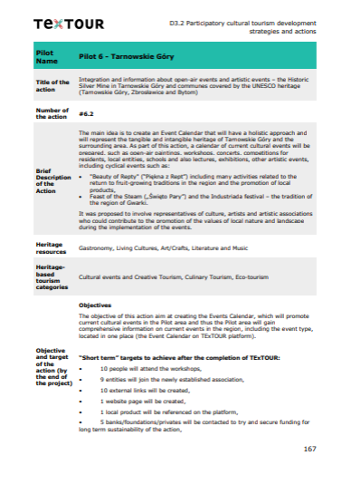
Step 6: Define a final action plan Agree on a final action plan
Aim: This step summarises all information gathered at previous stages within the co-development phase into a strict plan with time estimations, budget and responsibility.

Slide 37
Step 6: Define a final action plan Overview
Method: Filling out a template
Outcome: A finalised action plan with detailed actions

Slide 38
Third phase Implementation phase

Slide 39
Step 7: Implement activities
Time estimation: Depending on action plan
Milestone #7: Start the implementation of the action plan

Slide 40
Step 7: Implement activities Recommendations

Slide 41
Step 7: Implement activities Recommendations

Slide 42
Thank you for your attention

